Slide 1
Chapter 5
Large and Fast: Exploiting Memory Hierarchy
Notes:
Morgan Kaufmann Publishers
Chapter 5 — Large and Fast: Exploiting Memory Hierarchy

Slide 2
Associative Caches
Fully associative
  Allow a given block to go in any cache entry
  Requires all entries to be searched at once
  Comparator per entry (expensive)
n-way set associative
  Each set contains n entries
  Block number determines which set
    (Block number) modulo (#Sets in cache)
  Search all entries in a given set at once
  n comparators (less expensive)
Chapter 5 — Large and Fast: Exploiting Memory Hierarchy — <number>
Notes:
Morgan Kaufmann Publishers
Chapter 5 — Large and Fast: Exploiting Memory Hierarchy

Slide 3

Associative Cache Example
Chapter 5 — Large and Fast: Exploiting Memory Hierarchy — <number>
Notes:
Morgan Kaufmann Publishers
Chapter 5 — Large and Fast: Exploiting Memory Hierarchy

Slide 4
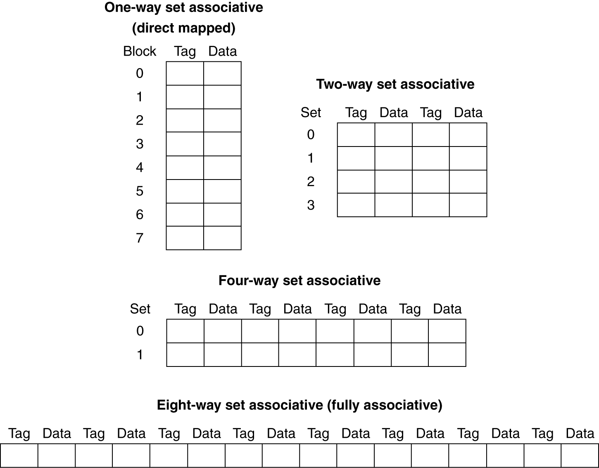
Spectrum of Associativity
For a cache with 8 entries
Chapter 5 — Large and Fast: Exploiting Memory Hierarchy — <number>
Notes:
Morgan Kaufmann Publishers
Chapter 5 — Large and Fast: Exploiting Memory Hierarchy

Slide 5
Associativity Example
Compare 4-block caches
  Direct mapped, 2-way set associative,
  fully associative
  Block access sequence: 0, 8, 0, 6, 8
Direct mapped
Block address | Cache index | Hit/miss | Cache content after access
 |  |  | 0 | 1 | 2 | 3
0 | 0 | miss | Mem[0]
8 | 0 | miss | Mem[8]
0 | 0 | miss | Mem[0]
6 | 2 | miss | Mem[0] |  | Mem[6]
8 | 0 | miss | Mem[8] |  | Mem[6]
Chapter 5 — Large and Fast: Exploiting Memory Hierarchy — <number>
Notes:
Morgan Kaufmann Publishers
Chapter 5 — Large and Fast: Exploiting Memory Hierarchy

Slide 6
Associativity Example
2-way set associative
Block address | Cache index | Hit/miss | Cache content after access
 |  |  | Set 0 |  | Set 1
0 | 0 | miss | Mem[0]
8 | 0 | miss | Mem[0] | Mem[8]
0 | 0 | hit | Mem[0] | Mem[8]
6 | 0 | miss | Mem[0] | Mem[6]
8 | 0 | miss | Mem[8] | Mem[6]
Fully associative
Block address |  | Hit/miss | Cache content after access
0 |  | miss | Mem[0]
8 |  | miss | Mem[0] | Mem[8]
0 |  | hit | Mem[0] | Mem[8]
6 |  | miss | Mem[0] | Mem[8] | Mem[6]
8 |  | hit | Mem[0] | Mem[8] | Mem[6]
Chapter 5 — Large and Fast: Exploiting Memory Hierarchy — <number>
Notes:
Morgan Kaufmann Publishers
Chapter 5 — Large and Fast: Exploiting Memory Hierarchy

Slide 7
How Much Associativity
Increased associativity decreases miss rate
  But with diminishing returns
Simulation of a system with 64KB
D-cache, 16-word blocks, SPEC2000
  1-way: 10.3%
  2-way: 8.6%
  4-way: 8.3%
  8-way: 8.1%
Chapter 5 — Large and Fast: Exploiting Memory Hierarchy — <number>
Notes:
Morgan Kaufmann Publishers
Chapter 5 — Large and Fast: Exploiting Memory Hierarchy

Slide 8

Set Associative Cache Organization
Chapter 5 — Large and Fast: Exploiting Memory Hierarchy — <number>
Notes:
Morgan Kaufmann Publishers
Chapter 5 — Large and Fast: Exploiting Memory Hierarchy

Slide 9
Replacement Policy
Direct mapped: no choice
Set associative
  Prefer non-valid entry, if there is one
  Otherwise, choose among entries in the set
Least-recently used (LRU)
  Choose the one unused for the longest time
    Simple for 2-way, manageable for 4-way, too hard beyond that
Random
  Gives approximately the same performance as LRU for high associativity
Chapter 5 — Large and Fast: Exploiting Memory Hierarchy — <number>
Notes:
Morgan Kaufmann Publishers
Chapter 5 — Large and Fast: Exploiting Memory Hierarchy

Slide 10
Multilevel Caches
Primary cache attached to CPU
  Small, but fast
Level-2 cache services misses from primary cache
  Larger, slower, but still faster than main memory
Main memory services L-2 cache misses
Some high-end systems include L-3 cache
Chapter 5 — Large and Fast: Exploiting Memory Hierarchy — <number>
Notes:
Morgan Kaufmann Publishers
Chapter 5 — Large and Fast: Exploiting Memory Hierarchy

Slide 11
Multilevel Cache Example
Given
  CPU base CPI = 1, clock rate = 4GHz
  Miss rate/instruction = 2%
  Main memory access time = 100ns
With just primary cache
  clock rate = 4GHz = 4*10⁹ cycles/sec = 4 cycles/ns
  Miss penalty = 100ns*4cycle/ns = 400 cycles
  Effective CPI = 1 + 0.02 × 400 = 9
Chapter 5 — Large and Fast: Exploiting Memory Hierarchy — <number>
Notes:
Morgan Kaufmann Publishers
Chapter 5 — Large and Fast: Exploiting Memory Hierarchy

Slide 12
Example (cont.)
Now add L-2 cache
  Access time = 5ns
  Global miss rate to main memory = 0.5%
Primary miss with L-2 hit
  Primary stalls per instruction = 5ns*4cycles/ns = 20 cycles
Primary miss with L-2 miss
  Secondary stalls per instruction = 400 cycles
CPI = 1 + 0.02 × 20 + 0.005 × 400 = 3.4
Performance ratio = 9/3.4 = 2.6
Chapter 5 — Large and Fast: Exploiting Memory Hierarchy — <number>
Notes:
Morgan Kaufmann Publishers
Chapter 5 — Large and Fast: Exploiting Memory Hierarchy

Slide 13
Multilevel Cache Considerations
Primary cache
  Focus on minimal hit time
L-2 cache
  Focus on low miss rate to avoid main memory access
  Hit time has less overall impact
Results
  L-1 cache usually smaller than a single cache
  L-1 block size smaller than L-2 block size
Chapter 5 — Large and Fast: Exploiting Memory Hierarchy — <number>
Notes:
Morgan Kaufmann Publishers
Chapter 5 — Large and Fast: Exploiting Memory Hierarchy

Slide 14
Interactions with Advanced CPUs
Out-of-order CPUs can execute instructions during cache miss
  Pending store stays in load/store unit
  Dependent instructions wait in reservation stations
    Independent instructions continue
Effect of miss depends on program data flow
  Much harder to analyse
  Use system simulation
Chapter 5 — Large and Fast: Exploiting Memory Hierarchy — <number>
Notes:
Morgan Kaufmann Publishers
Chapter 5 — Large and Fast: Exploiting Memory Hierarchy

Slide 15

Interactions with Software
Misses depend on memory access patterns
  Algorithm behavior
  Compiler optimization for memory access
Chapter 5 — Large and Fast: Exploiting Memory Hierarchy — <number>
Notes:
Morgan Kaufmann Publishers
Chapter 5 — Large and Fast: Exploiting Memory Hierarchy

